Slide 1






PRESENTATION 2026
Pay Lens – visualising salary truth by AI & BI
Mentor Name
Student Name
Student Email
R. Umamaheshwari
Sneha khandelwal
Snehakhandelwal666@gmail.com

Slide 2

Outline
Abstract of the Project
Problem Statement
Proposed Solution
System Architecture
Live Demo of the Project
Embedded Video of Project
Conclusion
Future Scope

Slide 3
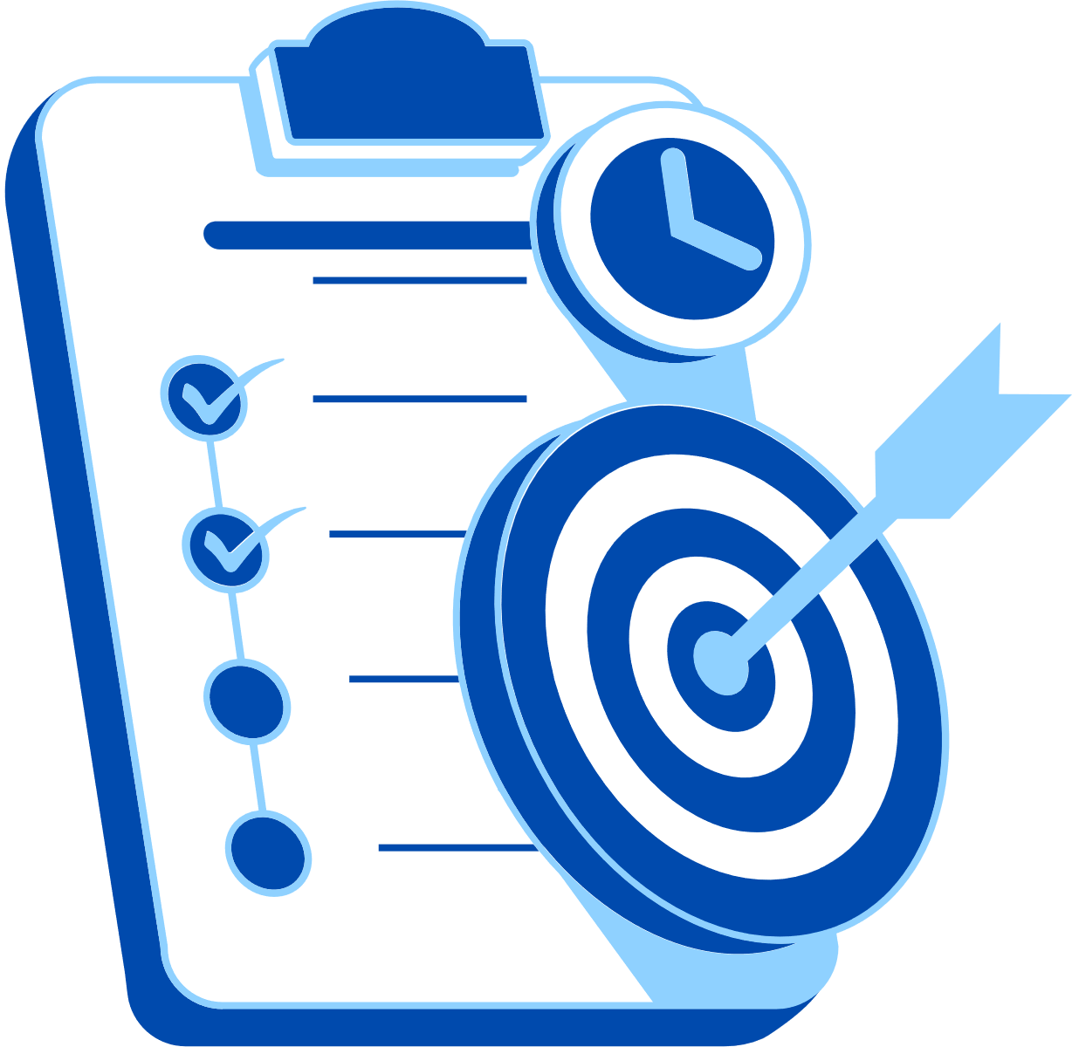
Abstract
Problem - Complexity of Payroll system, lack of clarity, overtime compliance & benchmarking.
Purpose - Building digital system combining tools, bridging gaps.
Tools – excel, power BI, copilot studio, AI assistant.
Expected – structured dataset with AI& BI augmented framework.
Solving problem for employees and employer.

Slide 4

Problem Statement
Information asymmetry.
Ensuring overtime compliance monitoring.
Equity benchmarking.
Significant as poor payroll transparency cause fairness issue, legal risk, employee distrust, salary disputes.
Affected user – HR, Blue collar & Gig Workers, Management.

Slide 5
Problem Statement
Limitation of existing tools:
Underutilized AI skills.
Benchmarking often outsourced.
Scope :
Payroll transparency, pay equity benchmarking, overtime compliance verification, and financial literacy for employees.
Limitation
Real – time integration & advanced ML Models

Slide 6

Proposed Solution
A digital Payroll solution, PAY-LENS proposed to enhance compensation transparency, automate discrepancy detection, compliance monitoring, employee accessibility.

Slide 7
Proposed Solution
Excel - structuring solves complexity.
Power BI – analytical modelling
Copilot – assistant
Agent & chatbot – employee facing tool for communication.
Employee and Employer friendly.

Slide 8
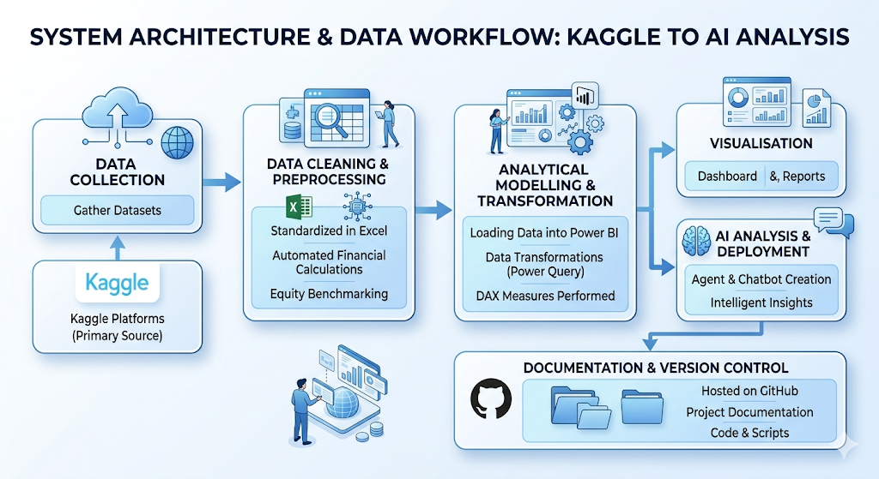
System Architecture

Slide 9
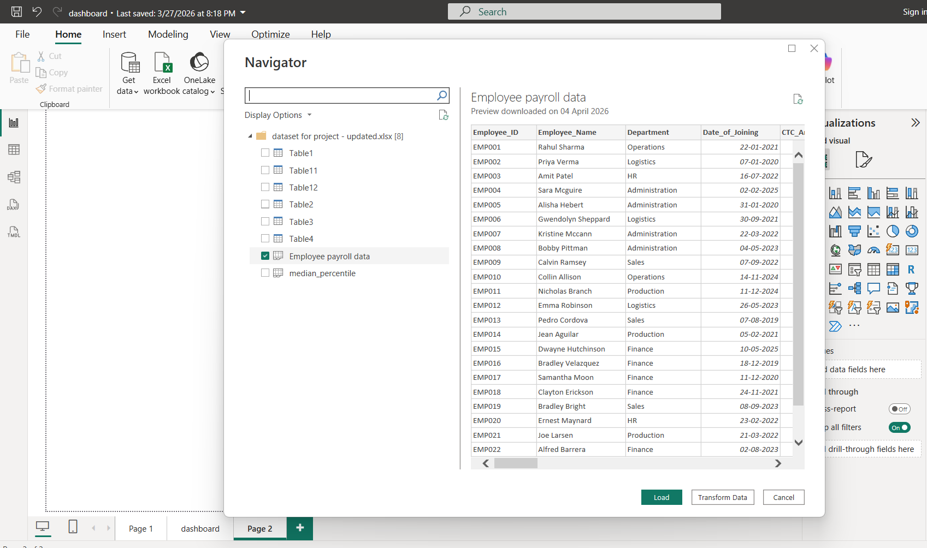
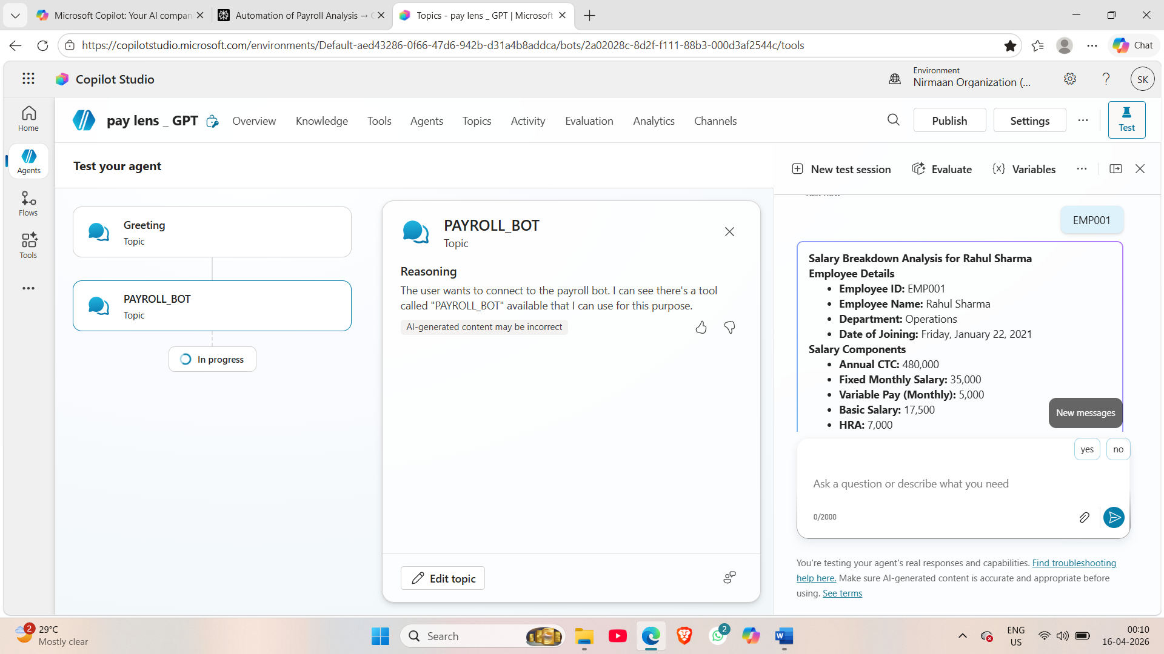
Live Demo of Project
Here's the list of some demo screenshots / features of the project:
Demo 1
Demo 2
Demo 3

Slide 10
Video of Project Demo
https://drive.google.com/file/d/16qmxqP11MpPYHH1ihfjbx9XcL1QYBSVm/view?usp=sharing
▶
[Insert your project demo video.
You can embed a video your live project.]

Slide 11
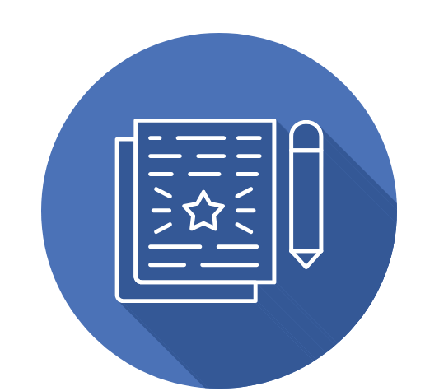
Conclusion
Intelligent Payroll Data Infrastructure
Automated Legal Alerts
Quantitative Pay Equity Framework
Financial Transparency for workforce
Decision – Intelligent Dashboard
Bridging transparency – skill - Analytical Gap.
CONCLUSION

Slide 12

Future Scope
Extend solution to SMEs, startups, and educational institutions for payroll transparency.
Excel through Macros and VBA and power Query enabled.
Real-Time Data Integration
Predictive Analytics
Mobile App Interface
Multilingual Support
Automated Benchmarking

Slide 13
Thank You
AICW Fellowship | Student Project Presentation 2026
LinkedIn | Edunet Foundation

